Slide 1
Installation
-Django Rest API

Slide 2
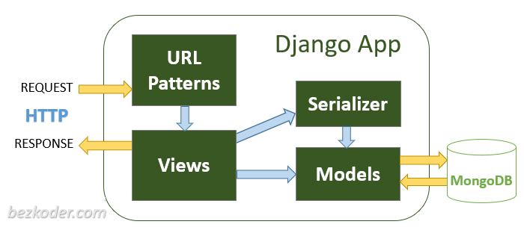
What is DRT?
Django REST framework is a powerful and flexible toolkit for building Web APIs.

Slide 3
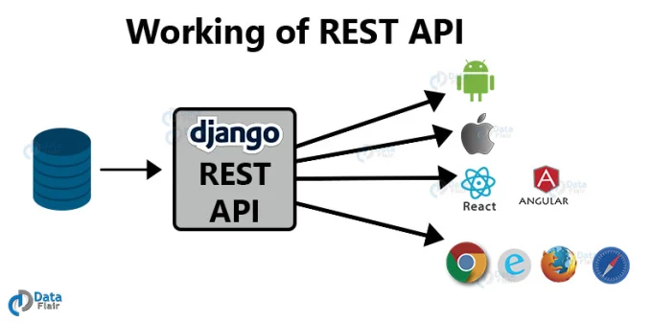

Slide 4
Install Python
Being a Python Web framework, Django requires Python.
Python includes a lightweight database called SQLite so you won’t need to set up a database just yet.
Get the latest version of Python at https://www.python.org/downloads/

Slide 5
Install Django Rest Framework
Requirements
REST framework requires the following:
Python (3.5, 3.6, 3.7, 3.8)
Django (1.11, 2.0, 2.1, 2.2, 3.0)
pip install djangorestframework

Slide 6
Update settings.py
INSTALLED_APPS =[
... 'rest_framework',
]

Slide 7
RESTful Structure
In a RESTful API, endpoints (URLs) define the structure of the API and how end users access data from our application using the HTTP methods: GET, POST, PUT, DELETE.
GET | POST | PUT | DELETE
/posts/ | Show all posts | Add new post | Update all posts | Delete all posts
posts/<id> | Show <id> | N/A | Update<id> | Delete id

